Slide 1


CAPSTONE PROJECT
Sales overview dashboard
Presented By
Student Name: Swayam Prakash pradhan
College Name: Siksha o anusandhan
Department: Bachelor of computer applications
Email ID: swayampradhan04@gmail.com

Slide 2
OUTLINE:
Problem Statement
Proposed System/Solution
System Development Approach
Algorithm & Deployment
Result
Conclusion
Future Scope
References

Slide 3
Problem Statement:
The lack of a consolidated and visible reporting system is making it difficult for the company to track and comprehend its entire sales performance across products, client categories, time periods, and regions. Key performance indicators including total sales, profit, quantity sold, and cost of products sold are currently difficult for decision-makers to rapidly identify and assess by product, business segment, and area. It becomes challenging to evaluate profitability across segments, identify underperforming goods, monitor profit margins over time, and comprehend each segment's contribution to overall sales without a unified dashboard. Furthermore, stakeholders are unable to see gains or drops in profits by segment, which hinders their capacity to make strategic or remedial decisions in a timely manner.

Slide 4
Proposed Solution:
The proposed system aims to provide a comprehensive sales performance monitoring solution by transforming raw business data into meaningful, actionable insights through an interactive dashboard. The solution focuses on consolidating sales, profit, quantity, and cost-related data to enable stakeholders to track performance across products, customer segments, time periods, and geographic regions effectively.
Data Collection:
The system will collect historical sales data including product details, sales revenue, profit, quantity sold, cost of goods sold (COGS), customer segments, country-wise sales, and time-based attributes such as year and month.
Data Preprocessing:
The collected data will be cleaned to handle missing values, duplicates, and inconsistencies. Necessary transformations such as data type conversion, aggregation, and normalization will be applied.
Dashboard Development:
An interactive dashboard will be developed using business intelligence tools to visualize KPIs, product-wise sales and profit, segment-wise performance, profit trends over time, and country-level analysis. Filters for year and country will allow users to dynamically explore the data.
Deployment:
The dashboard will be deployed in a user-friendly environment, ensuring accessibility, fast performance, and scalability for business users.
Evaluation:
Dashboard effectiveness will be evaluated based on usability, data accuracy, and stakeholder feedback, with continuous improvements made to enhance analytical value.

Slide 5
System Approach:
The system approach defines the structured methodology followed to design and implement the Sales Overview Dashboard using Power BI. The approach focuses on converting raw sales data into interactive and insightful visual reports.
System requirements
The Sales Overview Dashboard is developed using Microsoft Power BI, which serves as the primary business intelligence and data visualization system. Power BI is used for data connection, data transformation (Power Query), data modeling, DAX-based calculations, and interactive dashboard creation. Supporting systems include Microsoft Excel / CSV files as data sources and Power BI Service for publishing, sharing, and accessing the dashboard across the organization.
Library required to build the model
Power Query (M Language):
Used for data extraction, cleaning, transformation, and preparation (ETL process).
DAX (Data Analysis Expressions):
Used to create calculated measures and KPIs such as Total Sales, Total Profit, COGS, Quantity, and Profit Margin.
Power BI Visuals Library:
Built-in visualization components such as KPI cards, bar charts, line charts, donut charts, tables, and slicers to present insights interactively.
Power BI Data Model Engine:
Used for in-memory data storage, fast query processing, and efficient performance.
Power BI Service:
Used for publishing, sharing, and managing dashboards and reports online.

Slide 6
Algorithm & Deployment:
For the Sales Overview Dashboard developed using Power BI, no predictive or machine learning algorithm is used. The system relies on a Descriptive Analytics approach, where business performance is analyzed using DAX calculations and aggregation functions. Key metrics such as Total Sales, Total Profit, Quantity Sold, COGS, and Profit Margin are computed using DAX formulas (e.g., SUM, CALCULATE, DIVIDE). Trend analysis is performed using time-based aggregations to understand sales and profit patterns across years and segments. This rule-based analytical method helps summarize historical data and compare performance across different dimensions.
The dashboard is deployed using Power BI Service (Cloud Deployment). After development in Power BI Desktop, the report is published to the Power BI Service, allowing authorized users to access the dashboard through a web browser or mobile application. Role-based access control ensures data security, while scheduled data refresh enables up-to-date reporting. This deployment method ensures scalability, easy sharing, and real-time accessibility for stakeholders without requiring local installations.

Slide 7
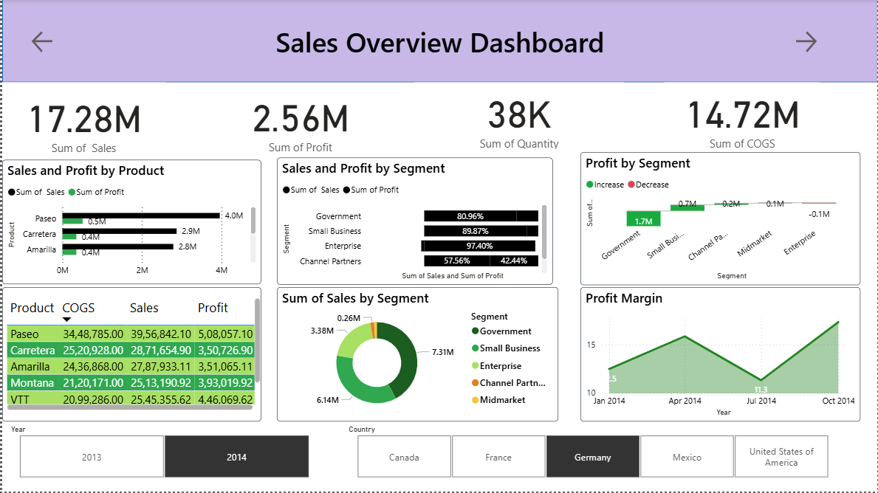
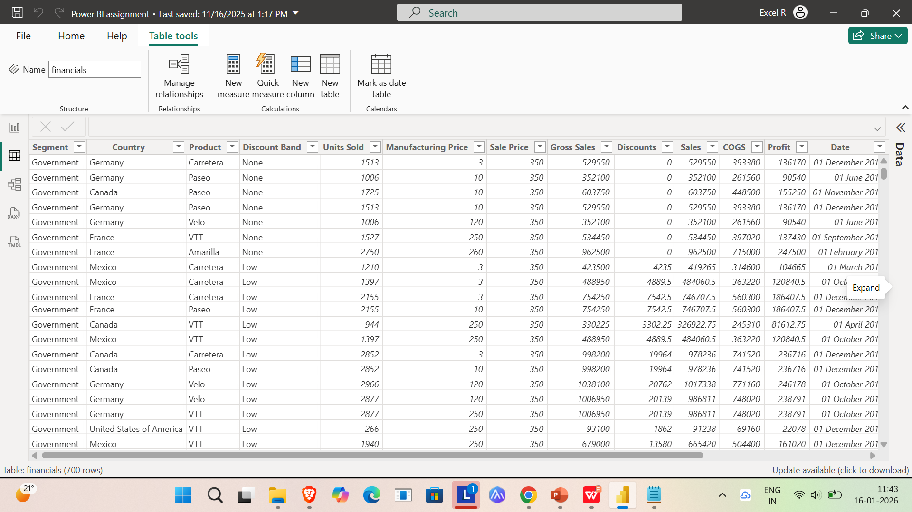
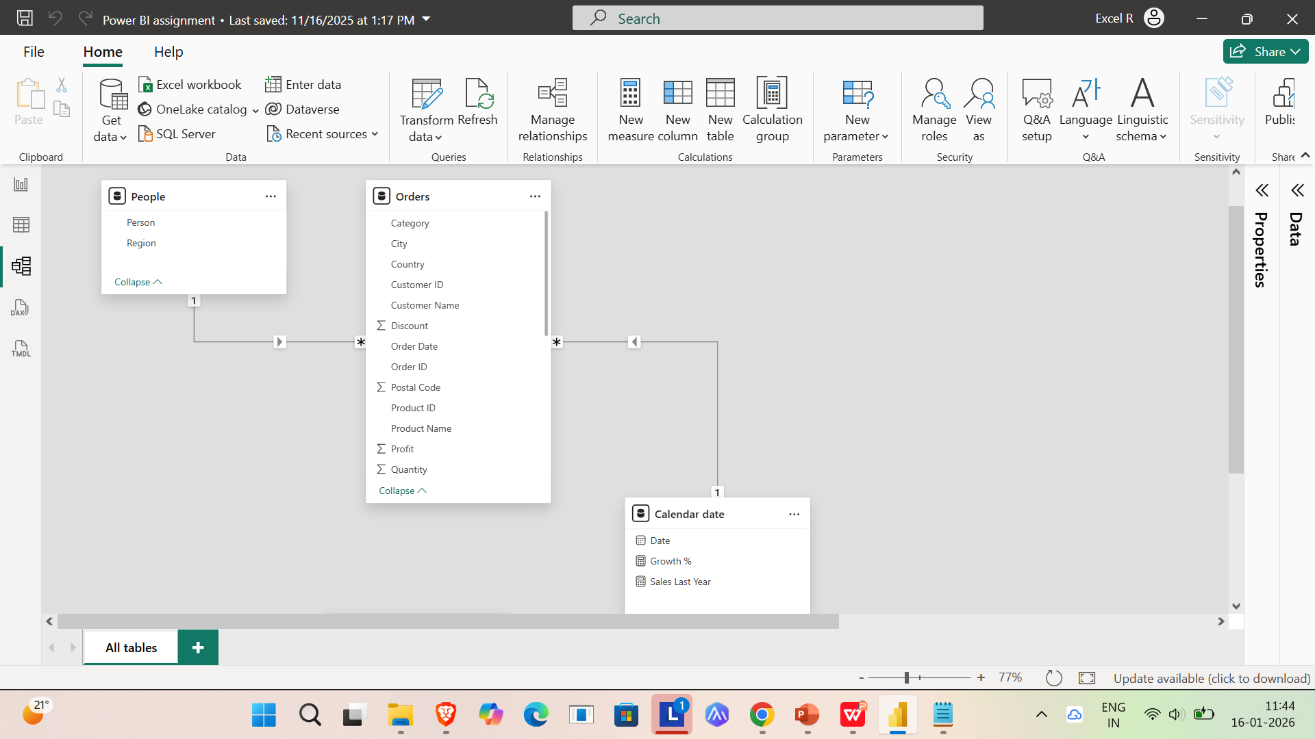
Result:

Slide 8
Conclusion:
The Sales Overview Dashboard developed using Power BI successfully transforms raw sales data into clear, interactive, and meaningful business insights. By using descriptive analytics and DAX-based calculations, the dashboard enables stakeholders to monitor key performance indicators such as sales, profit, quantity, and cost across products, segments, time periods, and regions. The interactive visuals and filters allow users to easily explore trends, identify high-performing and underperforming areas, and support data-driven decision-making. Deployment through Power BI Service ensures accessibility, scalability, and timely updates, making the dashboard an effective tool for improving business visibility, performance analysis, and strategic planning.

Slide 9
Future scope:
The Sales Overview Dashboard can be further enhanced to provide deeper insights and advanced analytical capabilities. In the future, predictive analytics and forecasting models can be integrated to estimate future sales and profit trends. Real-time data connections can be implemented to enable live monitoring of sales performance. Advanced DAX measures and AI visuals can be added to identify patterns, anomalies, and key drivers of performance. Role-level security can be strengthened to provide customized views for different stakeholders. Additionally, the dashboard can be expanded to include customer behavior analysis, regional performance benchmarking, and integration with other business systems such as ERP or CRM platforms, making it a more comprehensive and intelligent decision-support system.

Slide 10
References:
[1] https://www.kaggle.com/discussions/general/417585
[2] https://github.com/TheMrityunjayPathak/RetailStoreSalesDashboard/tree/main/Dataset
[3] https://www.kaggle.com/datasets/shantanugarg274/sales-dataset
GitHub Link: https://github.com/Swayampradhan/sales-overview-dashboard/tree/main

Slide 11
Thank You

